Slide 1
Zeroth Order optimization for (Black box) Adversarial Attacks
Giacomo Virginio, Mikhail Kolobov
Department of Mathematics, Università degli Studi di Padova

Slide 2
Algorithms
Stochastic Gradient Free Frank Wolfe [Sahu et al.]
Faster Zeroth-Order Conditional Gradient Method [Gao et al.]
Zero-Order Stochastic Conditional Gradient Sliding [Lobanov et al.]

Slide 3
Stochastic Gradient Free Frank Wolfe
One of the first approaches to stochastic zeroth order Frank Wolfe
Random directions gradient estimator
Averaging trick to counter diverging gradient

Slide 4
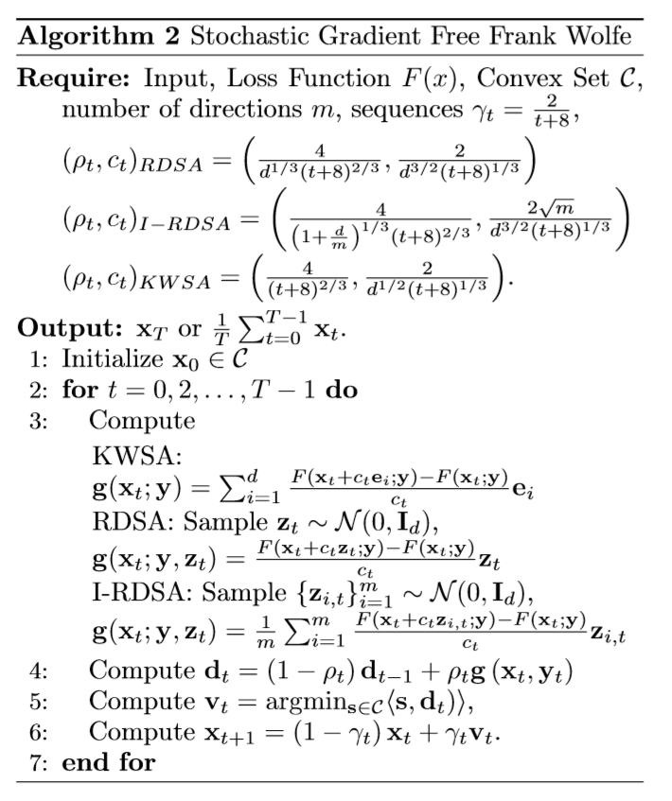
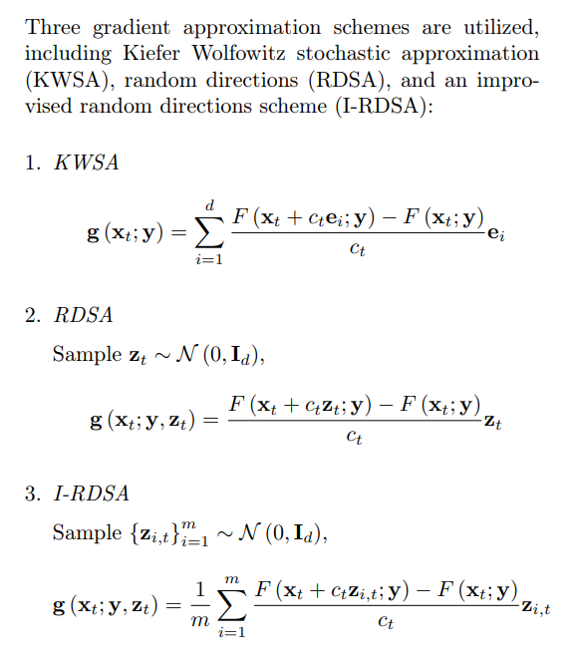
Stochastic Gradient Free Frank Wolfe

Slide 5
Faster Zeroth-Order Conditional Gradient Method
Coordinate wise gradient
Variance reduction technique
Conditional gradient sliding in the subproblem

Slide 6
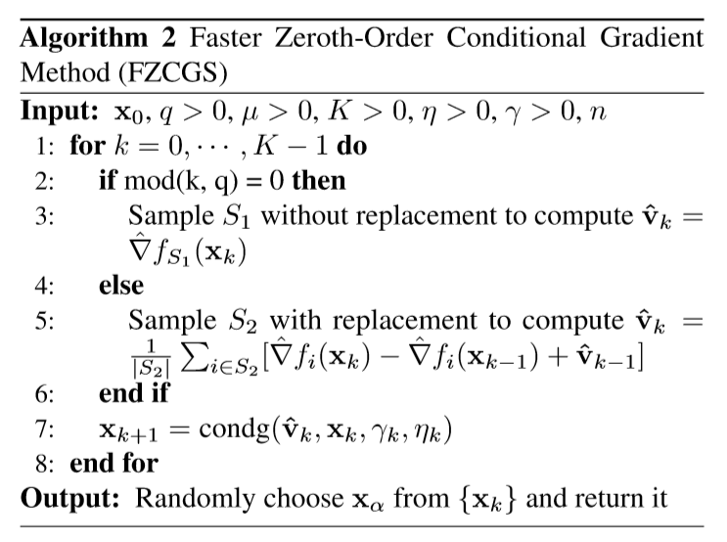
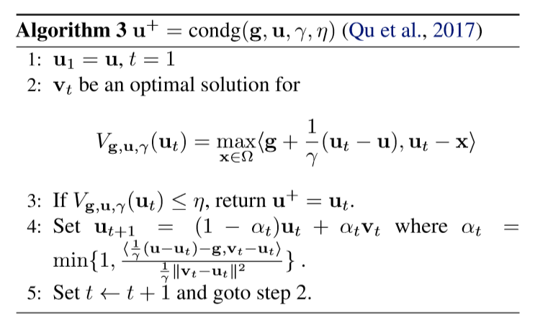
Faster Zeroth-Order Conditional Gradient Method

Slide 7
Zero-Order Stochastic Conditional Gradient Sliding
L2-sphere randomization for directions
Conditional gradient sliding

Slide 8
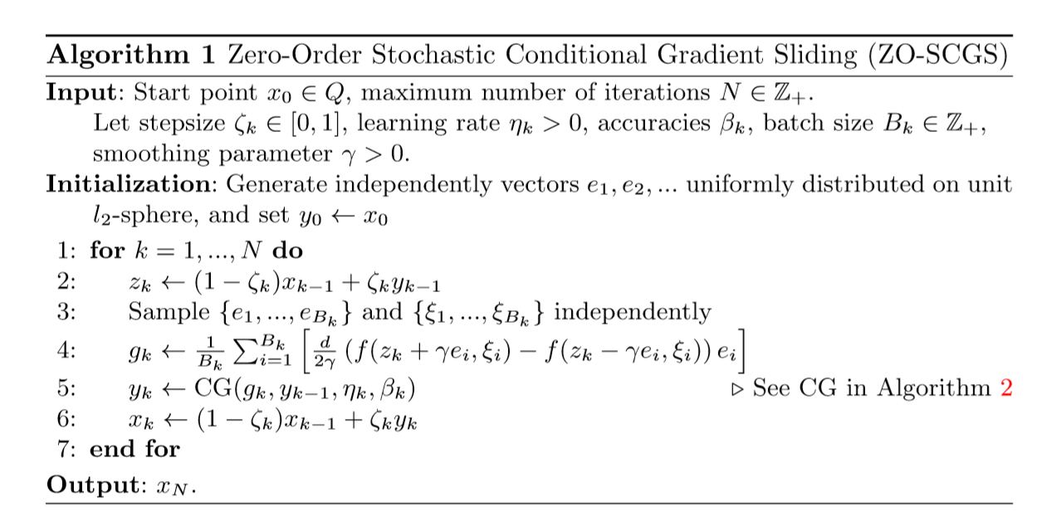
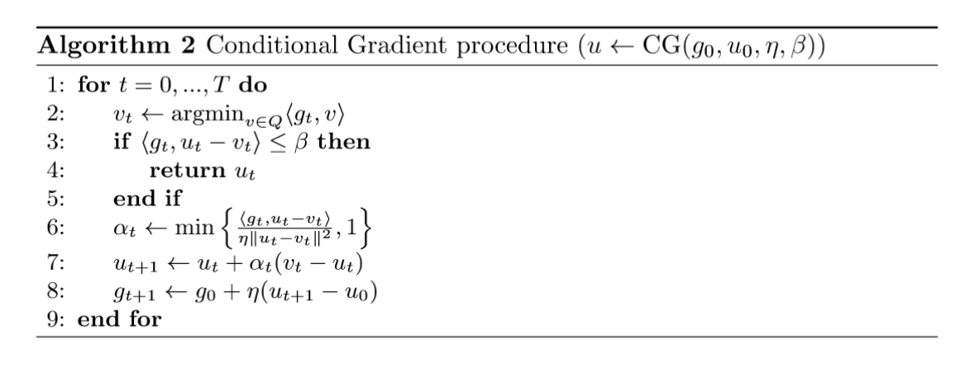
Zero-Order Stochastic Conditional Gradient Sliding

Slide 9
Experiments
Black box adversarial attack
nn-Carlini applied to MNIST dataset

Slide 10
Changes to theoretical code
ZOSCGS uses a fixed parameter for number of randomized directions used in gradient estimation (B[k]);
FZCGS gradient estimation calculated over random directions instead of using basis vector;
CG in FZGCS changes with the CG version used by ZOSCGS;
CG step has an ulterior stopping condition, based on the alpha parameter.

Slide 11
Feasible Sets
∥δ∥∞ ≤ s s set to 8 for the KW version of SGFFW s set to 4 for the other versions of SGFFW and FZCGS;
The set containing all possible directions in which the sum of elements is equal to 0, all elements except one are equal to 2000/d, and their opposite. Built with the following commands: num=2000, Q=np.eye(d)*num, Qrm=np.full(Q.shape,num/d), Q=Q-Qrm, Q=np.concatenate((Q,-Q), axis=1)

Slide 12
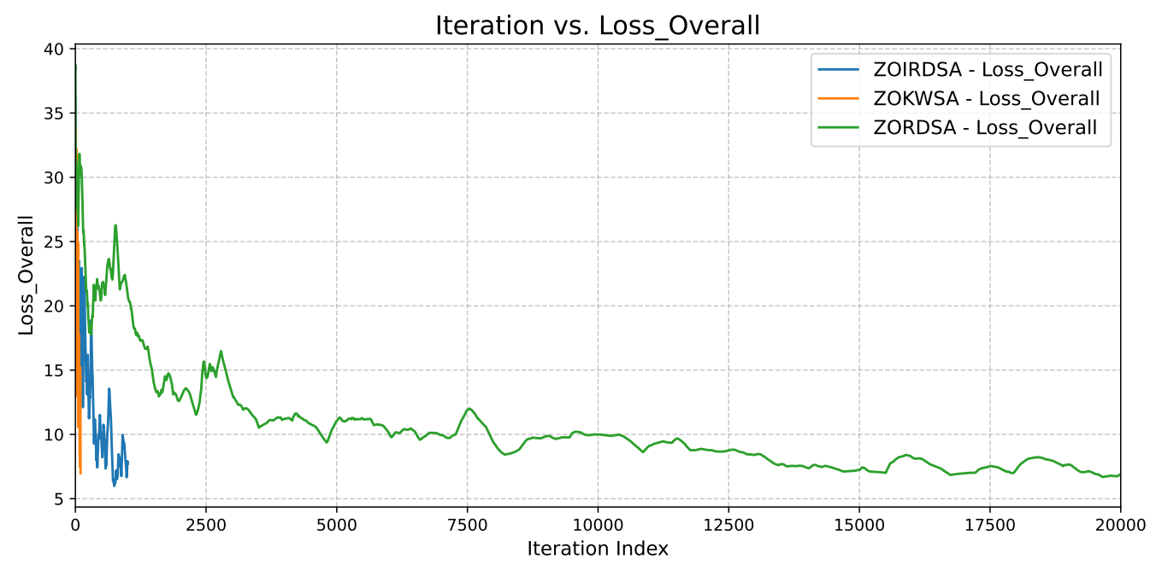
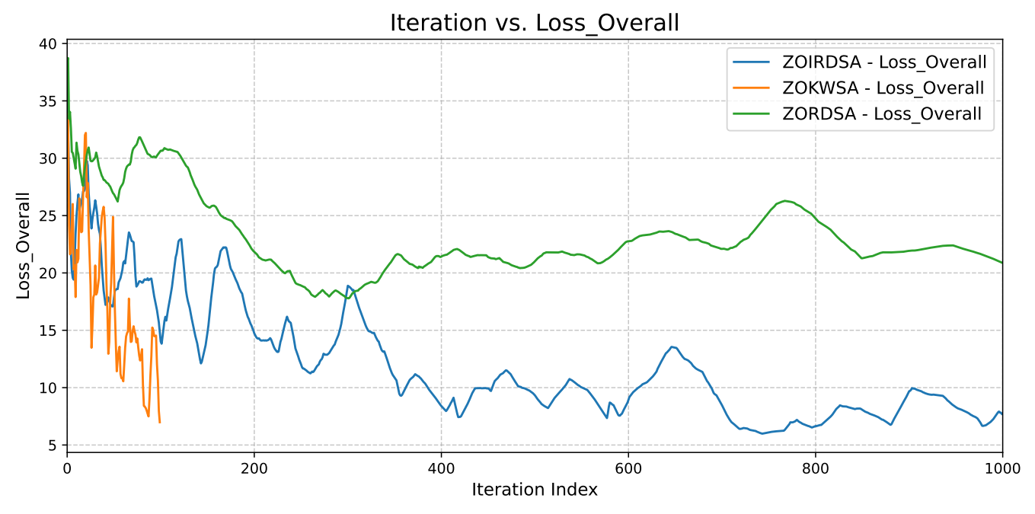
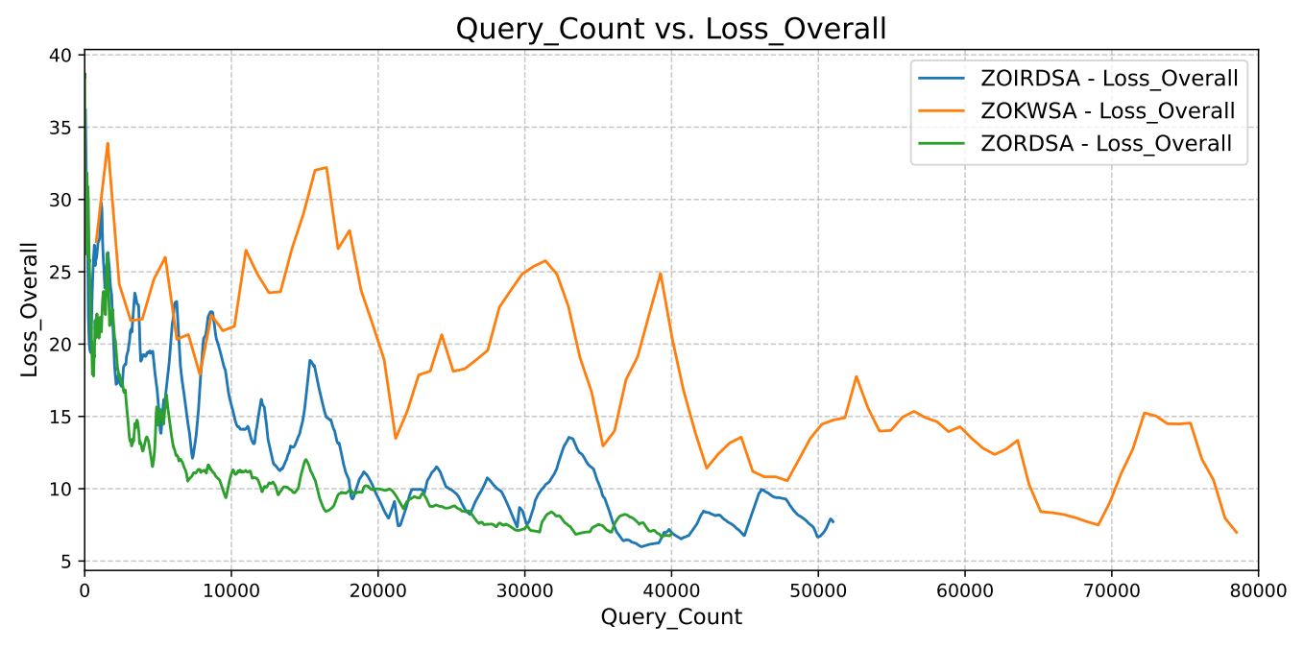
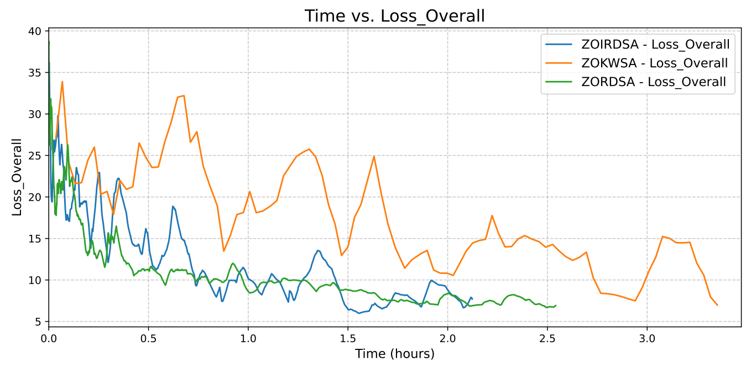
Results – SGFFW comparison

Slide 13
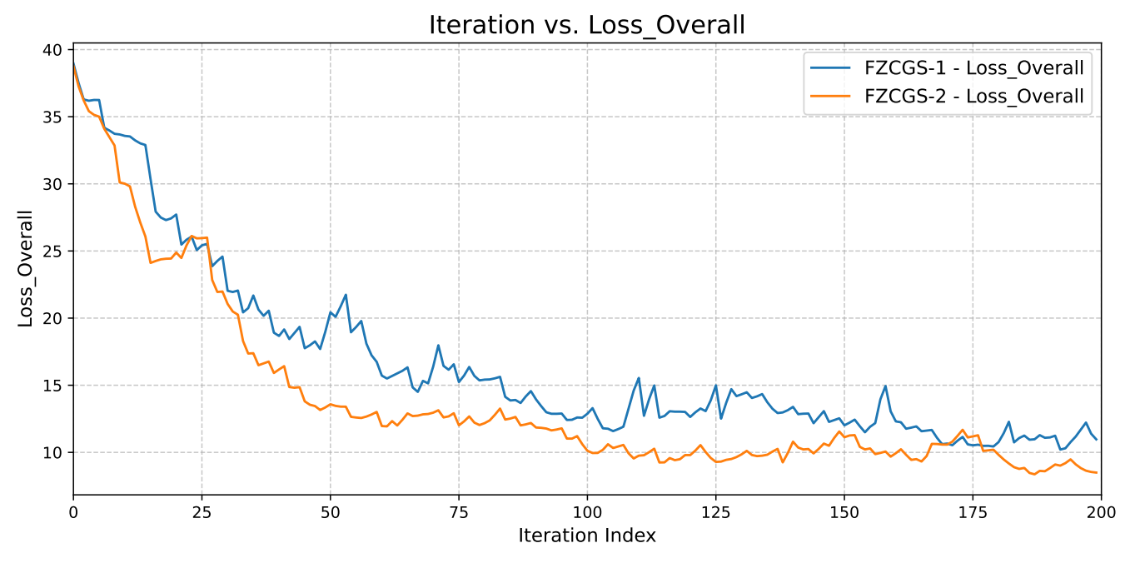
Results – Feasible sets comparison on FZCGS

Slide 14
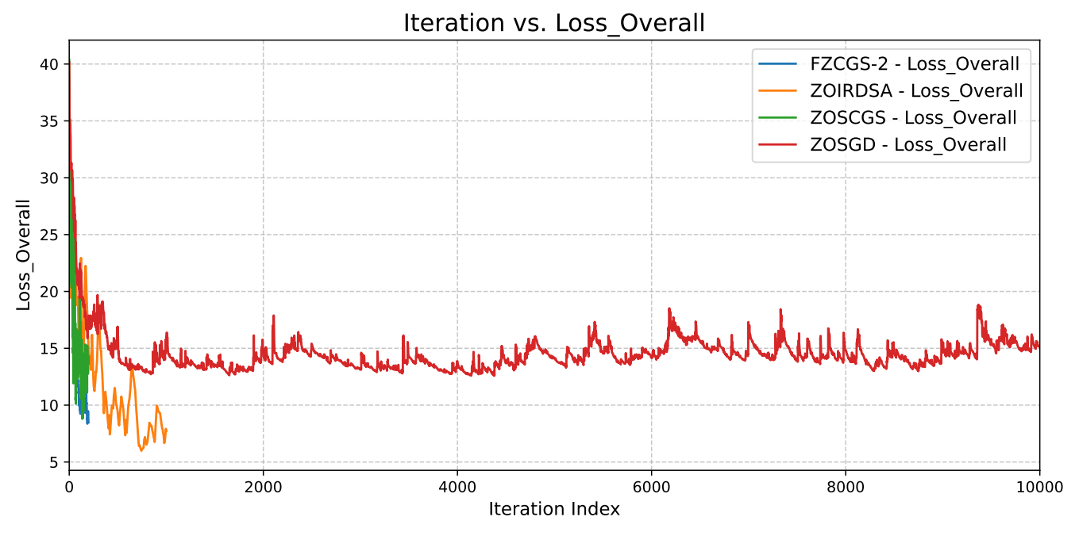
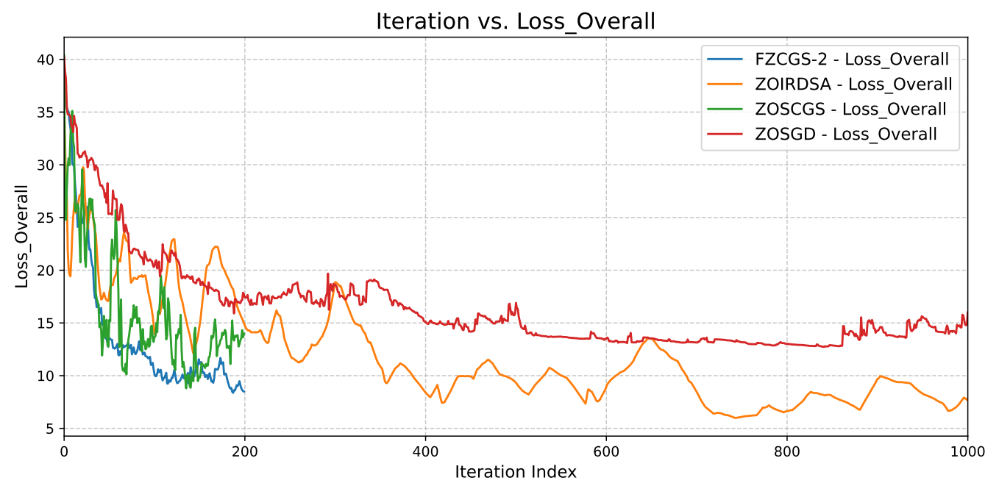
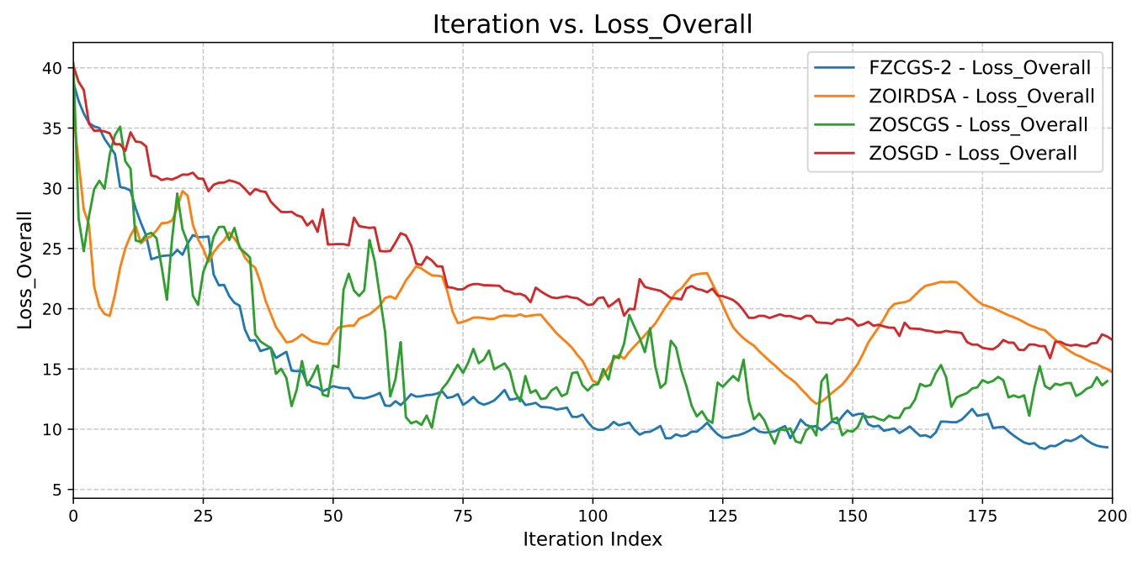
Results – Overall Comparison (Iteration)

Slide 15
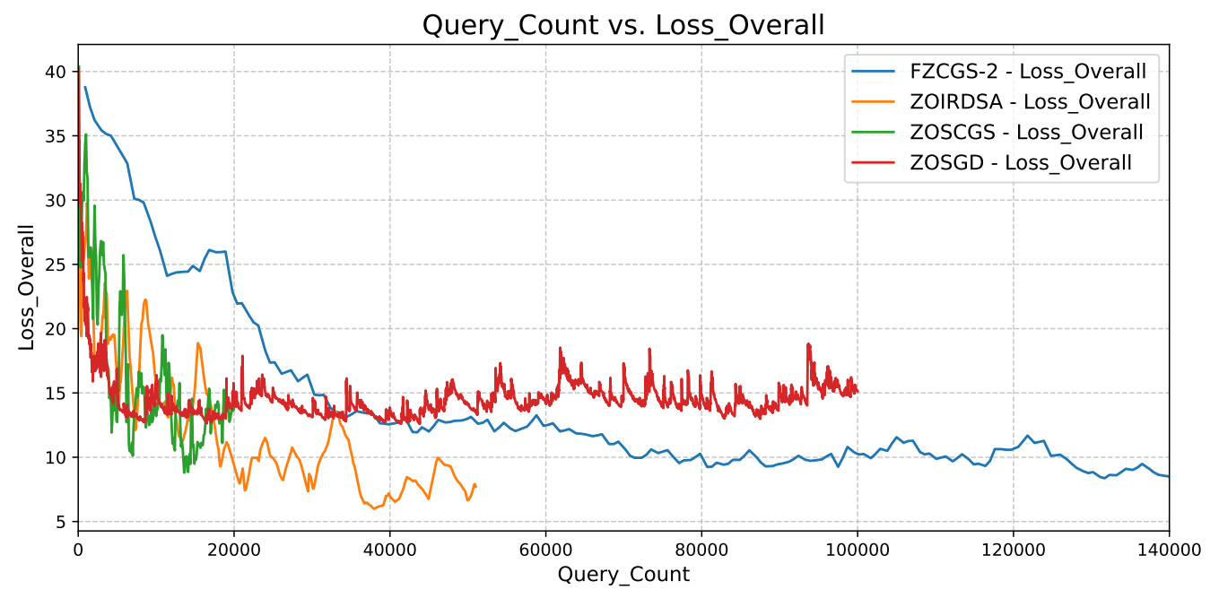
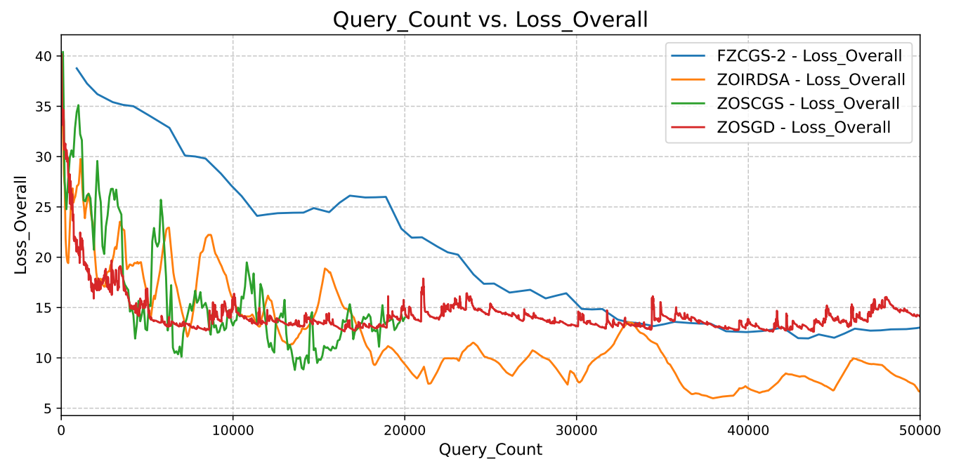
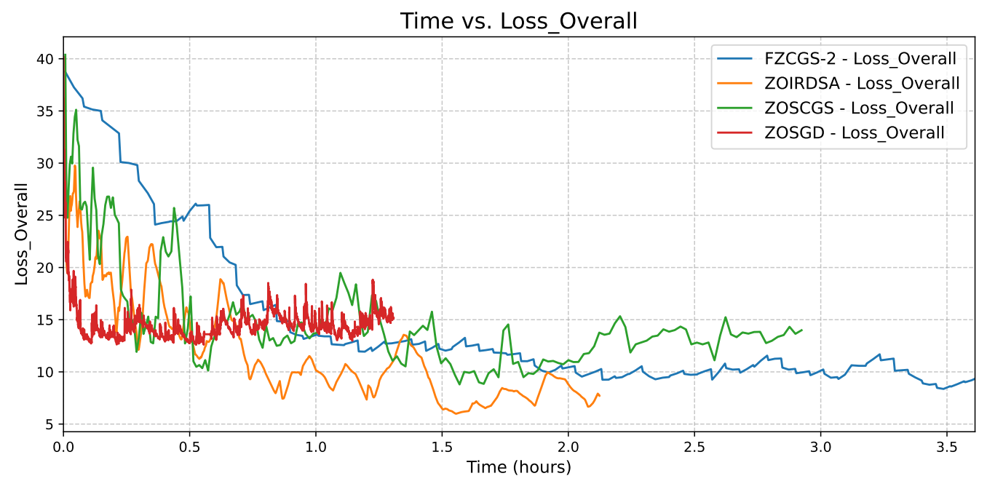
Results – Overall Comparison (Query & Time)

Slide 16
Conclusion
No algorithm is the best overall, all have their strengths and weaknesses:
FZCGS - best performance for iterations, worst for queries and time (up to a point);
I-RDSA – not as good for iterations, very good performance query and time, reaching the lowest overall loss in our tests;
ZOSCGS - not the single best in any category, but has most balanced performance, good results in all three categories.

